Slide 1
Class 16: Bagging and Random Forests
MGSC 310
Ben Labaschin

Slide 2
Class 16: Outline
Bagging and Ensemble Methods
Random Forests
Random Forest Lab

Slide 3

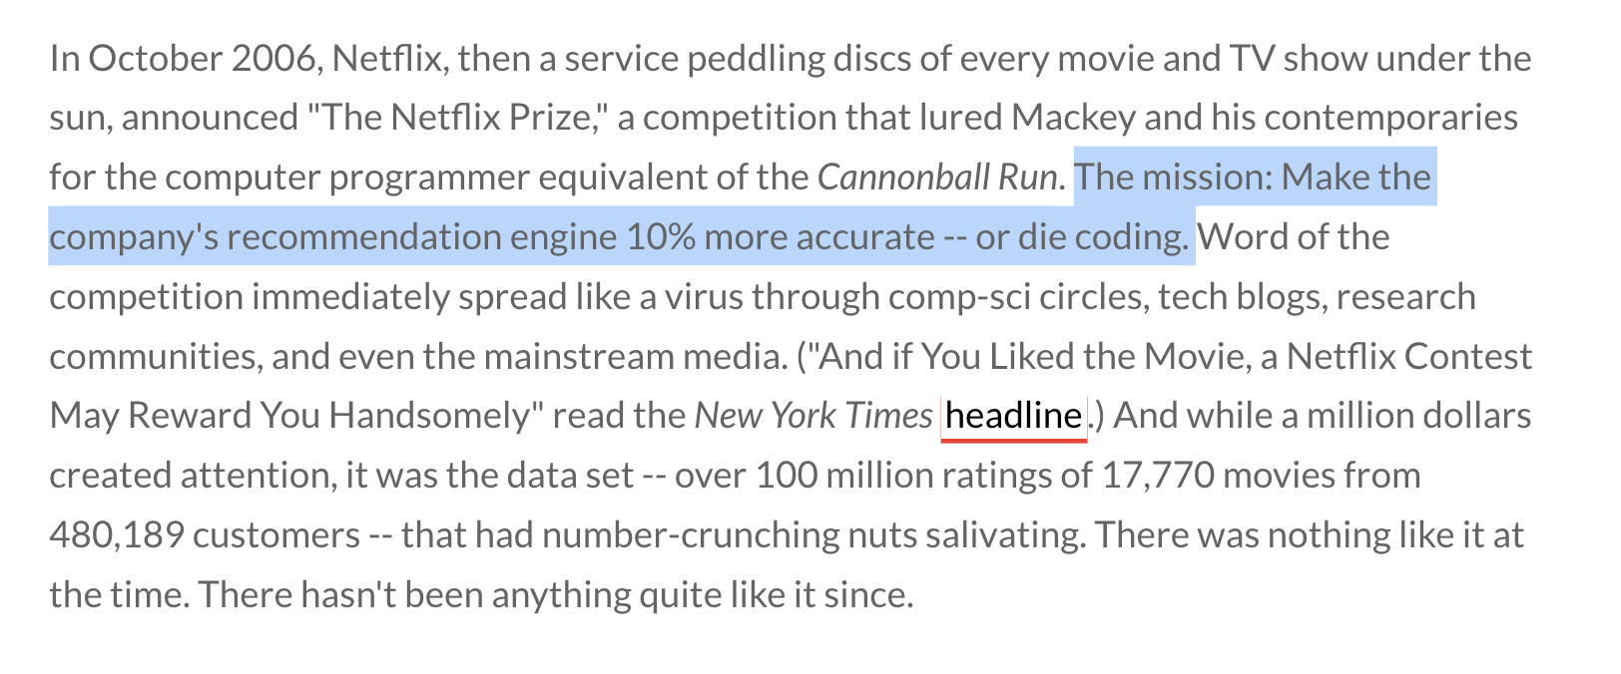
https://www.thrillist.com/entertainment/nation/the-netflix-prize

Slide 4
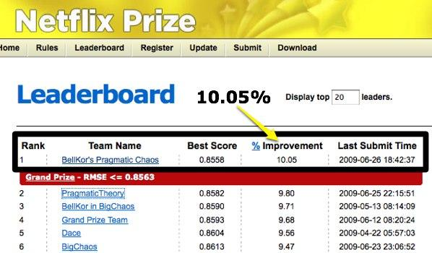
Netflix prize

Slide 5
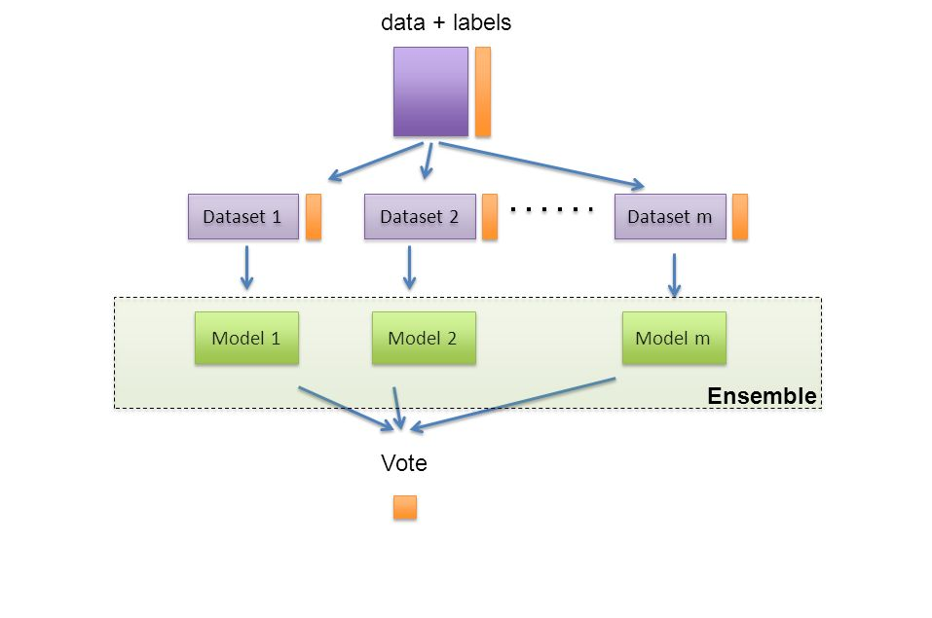
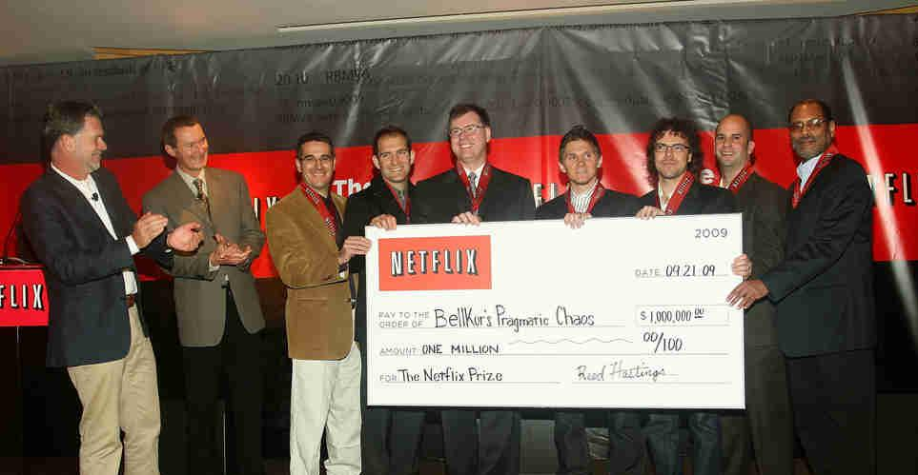
Netflix prize winners
Punchline: simple models beat out one very deep model

Slide 6
Netflix prize conclusion: ensemble of simple methods beats one complex method

Slide 7
But what is an ensemble model?
Definition:
An ensemble model is any algorithm that combines multiple machine learning techniques into a single predictive model to decrease variance (bagging), bias (boosting), or improve predictions (stacking).
Key Insight:
The key idea behind ensemble models is that they combine multiple weak models that together can produce a more accurate and robust model than each can by itself.
Most ensembles predict by “voting” on a path forward.
Think of an ensemble model as relying on “the wisdom of the crowd.”

Slide 8
Types of Ensemble Models
Bagging (Bootstrap Aggregating): Reduces variance, helps avoid overfitting.
Example Algorithms:
Random Forest
Extra Trees Classifier
Bagged Decision Trees
Boosting: Reduces bias, focuses on instances the model previously got wrong.
Example Algorithms:
XGBoost
LightGBM
CatBoost
Stacking: Combines predictions from multiple models to improve accuracy.
Example Algorithms:
Stacked Generalization
Blending Models

Slide 9
Bootstrapping Data: A Point We’ve Alluded to All Semester
Definition:
Bootstrapping involves randomly sampling with replacement from a dataset, creating multiple different training datasets.
Purpose:
This allows for an estimation of the distribution of a statistic (e.g., mean, variance) by resampling the data.
In other words, we attempt to imitate the data generating distribution of the data we originally received!
Bootstrap in Ensemble Models
Each model in a bagging ensemble is trained on a different bootstrap sample.
Variance Reduction: By training on various bootstrap samples, bagging reduces the variance of the prediction error.

Slide 10
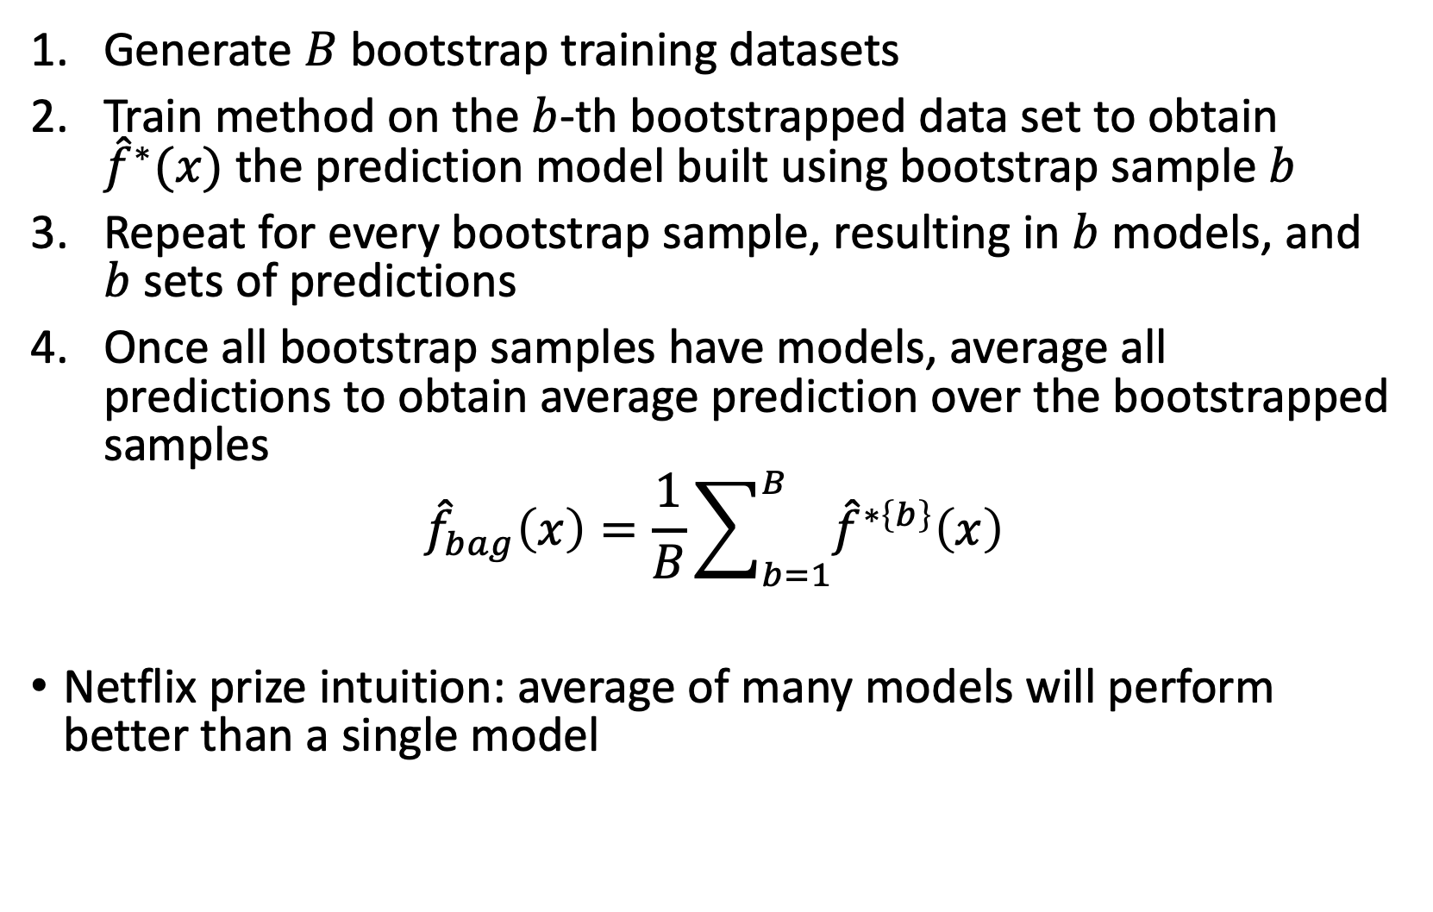
Bagging (Bootstrap Aggregation) Algorithm

Slide 11
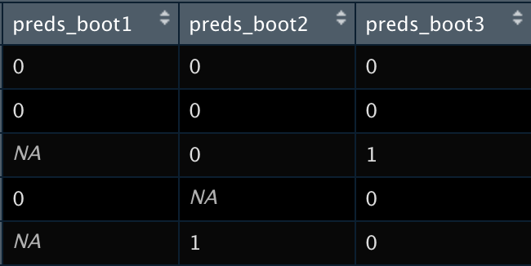

Out-of-bag error
Recall that for each bootstrapped sample b is composed of a subset of the total training data
For each sample, the data not used to fit the model is referred to as out-of-bag (OOB) observations
We can better approximate out of sample error by only using out-of-bag observations for model validation

Slide 12
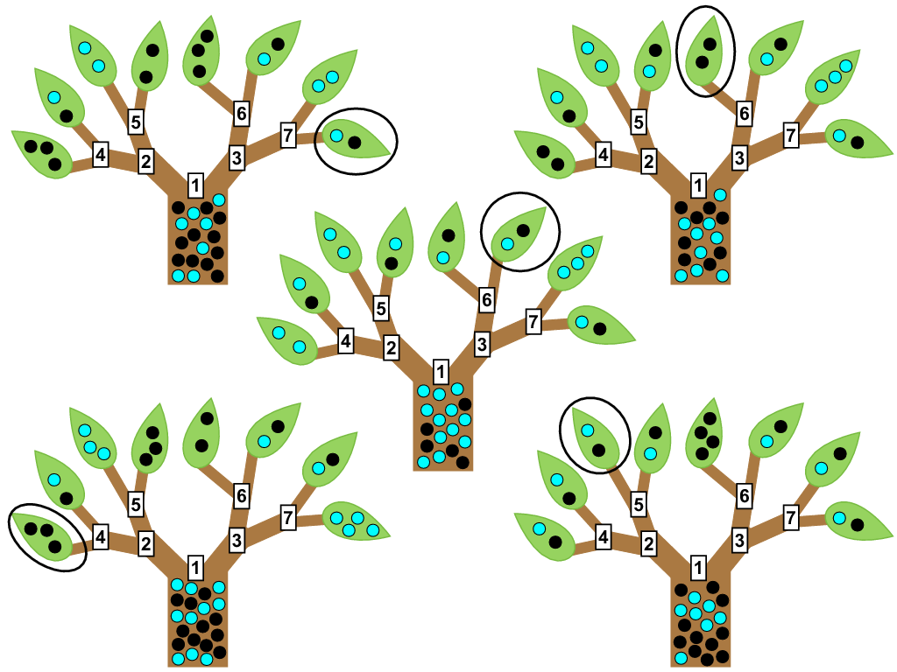
Random Forests
Random forests are a slight trick to bagging that highly improves predictive power
Many trees do poorly because the stepwise greedy algorithm doesn’t fully explore variable and parameter space
Random forests is like bagging, only each time a split in a tree is considered, a random selection of m predictors is chosen as split candidate
A fresh set of m predictors is taken at each split.

Slide 13
How Random Forests Work
Overview
Each tree in a random forest is built from a sample drawn with replacement (bootstrap sample) from the training set.
At each node in the tree, a subset of features is randomly selected to determine the split.
Random Forest Algorithm (Simplified)
For each tree in the forest:
Draw a bootstrap sample from the training data.
Grow a decision tree. For every node:
Randomly select d features (where d is a hyperparameter).
Find the best split using the selected features.
Split the node into child nodes.
Repeat step 2 until a stopping criterion is met (e.g., maximum depth).
Prediction
Classification: Use majority voting from all trees.
Regression: Calculate the average of predictions from all trees.

Slide 14
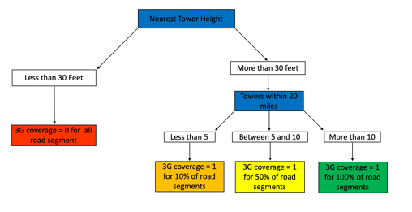
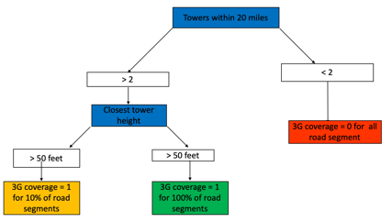
Random Forest Model: Many Decision Trees
B bootstrap
sampes of data
(~ 1000)
…
Bootstrap 1
Bootstrap b
Bootstrap 1000
Tree 1
Tree b
Tree 1000
Vote individual i survived = 0 or 1
Vote individual i survived = 0 or 1
Vote individual i survived = 0 or 1

Slide 15
(Gradient) Boosting
Definition:
A sequential process where each subsequent model attempts to correct the errors of the previous models..
Purpose:
To convert a set of weak learners into a strong learner.
How Boosting Works
Sequential Training: Models are trained sequentially with each model learning from the errors of its predecessors.
Weight Adjustment: Incorrect predictions in the previous model increase the weight of these instances in the next model.
Gradient Descent Algorithm:
At each step, gradient boosting uses the gradient descent algorithm to minimize the loss function (a measure of how far the model's predictions are from the actual values). In simple terms, it iteratively adjusts the model in the direction that reduces the loss.

Slide 16
XGBoost: A Powerful Library
Definition: eXtreme Gradient Boosting (XGBoost) is an efficient and scalable implementation of gradient boosting.
Gradient Boosting Framework: Builds trees one at a time, where each new tree helps to correct errors made by previously trained tree.
Regularization: Includes L1 (Lasso) and L2 (Ridge) regularization to prevent overfitting.
How Boosting Works
Sequential Training: Models are trained sequentially with each model learning from the errors of its predecessors.
Weight Adjustment: Incorrect predictions in the previous model increase the weight of these instances in the next model.

Slide 17

Similarity Score: The XGBoost Split Criterion
Gradient and Hessian
In each iteration, XGBoost calculates the gradient (FoD) and Hessian (SoD) of the loss function for each instance.
Gradient: indicates the direction of the steepest increase or decrease in the loss function
Hessian: provides information about how quickly this rate of change is itself changing. Tells you about the curvature of the loss function at a particular point.
Similarity Score Calculation
The similarity score for a given node is calculated using the formula:
Numerator: Sum of gradients of the loss function for all instances in the node,
Denominator: Sum of the second-order gradients. Lambda is a regularization parameter.

Slide 18
Similarity Score Continued
Split Finding
XGBoost examines different possible splits and calculates how much each split will reduce the loss function, which involves comparing the similarity scores.
The reduction in loss, or "gain", from a potential split is given by:
A split is chosen to maximize this gain.
Regularization
The similarity score includes the regularization term \( \lambda \) (also known as the "lambda" parameter in XGBoost). This regularization term helps to avoid overfitting by penalizing complex models.
Pruning
After the tree is fully grown, XGBoost can prune it by removing splits that do not provide enough gain, as determined by another regularization parameter (gamma).

Slide 19
Bagging, Boosting, and Stacking in Python
To the code!

Slide 20
Class 17 Summary
Regression trees use binary decisions of the X variables to predict the outcome.
Regression trees can be used for either regression or classification problems.
We must control the depth and/or complexity of a tree or else it is prone to overfitting.
Bagging is an ensemble method that combines many models.
Bagging stands for “bootstrap aggregation” where we combine predictions from models estimated against many bootstrapped datasets.

